Slide 1
130nm and 90nm ASIC Technologies for SLHC applications at CERN
Ecole IN2P3 de microélectronique 2009
Kostas Kloukinas
CERN, PH-ESE dept.
CH1211, Geneve 23
Switzerland

Slide 2
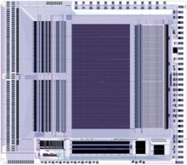

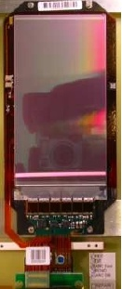
Microchips for Megastructures
Support of microelectronic technologies for SLHC upgrades.
Front-End ASIC
CMS experiment in the LHC accelerator at CERN
Silicon Tracker Hybrid

Slide 3
Overview
130nm and 90nm Technologies
130nm Mixed Signal Design Kit & Methodologies
Digital Block Implementation flow
Access to Foundry Services

Slide 4
Overview of Technologies
CMOS 8RF-LM
Low cost technology for
Large Digital designs
CMOS 8RF-DM
Low cost technology for
Analog & RF designs
BiCMOS 8WL
Cost effective technology for Low Power RF designs
BiCMOS 8HP
High Performance technology for demanding
RF designs
CMOS 9SF LP/RF
High performance technology for dense designs
130nm CMOS
90nm CMOS
Access to Foundry services & Technology technical support.
130nm (CMOS & BiCMOS) and 90nm contract available since 6/2007.
Future technologies can be negotiated with the same manufacturer, once the necessity arise.

Slide 5
CMOS8RF
130nm technology

Slide 6
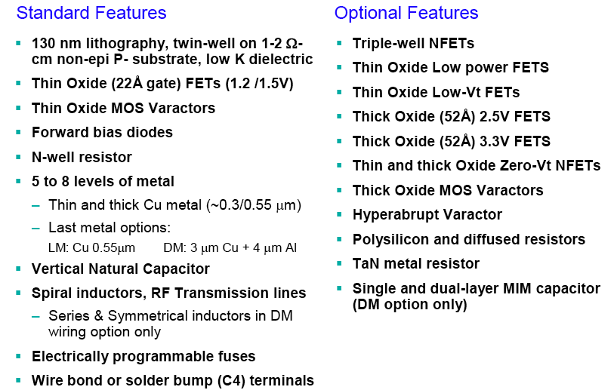
CMOS8RF Technology Features
Notes:
Starting wafer is doped p-type with a resistivity of 1-2 Ohm-cm.
The technology utilizes shallow trench isolation (STI), nominally 0.35 μm deep into the silicon, to provide a dense isolation between FETs and other
devices. All diffusions and polysilicon are silicided for low resistivity unless the silicide formation is intentionally blocked to form a resistor.
CMOS8RF provides a comprehensive suite of devices. The standard manufacturing flow has
been designed to provide the set of devices shown in the left column in the above slide. Optional
devices which need additional mask set are shown in the right hand column.

Slide 7
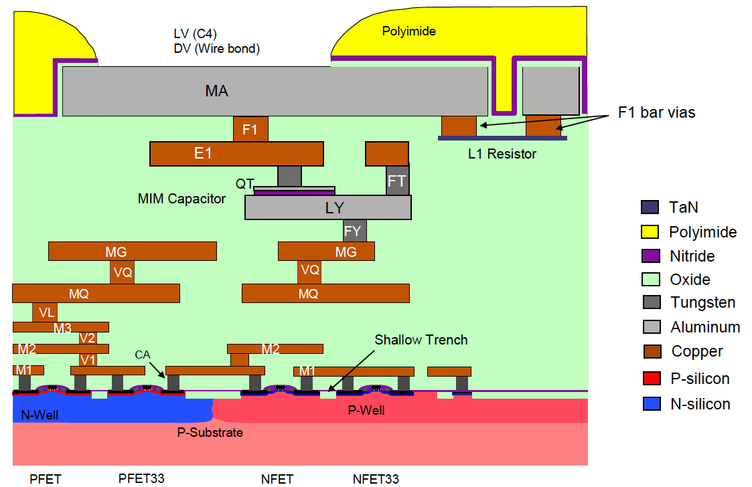
Process cross-section (DM)

Slide 8
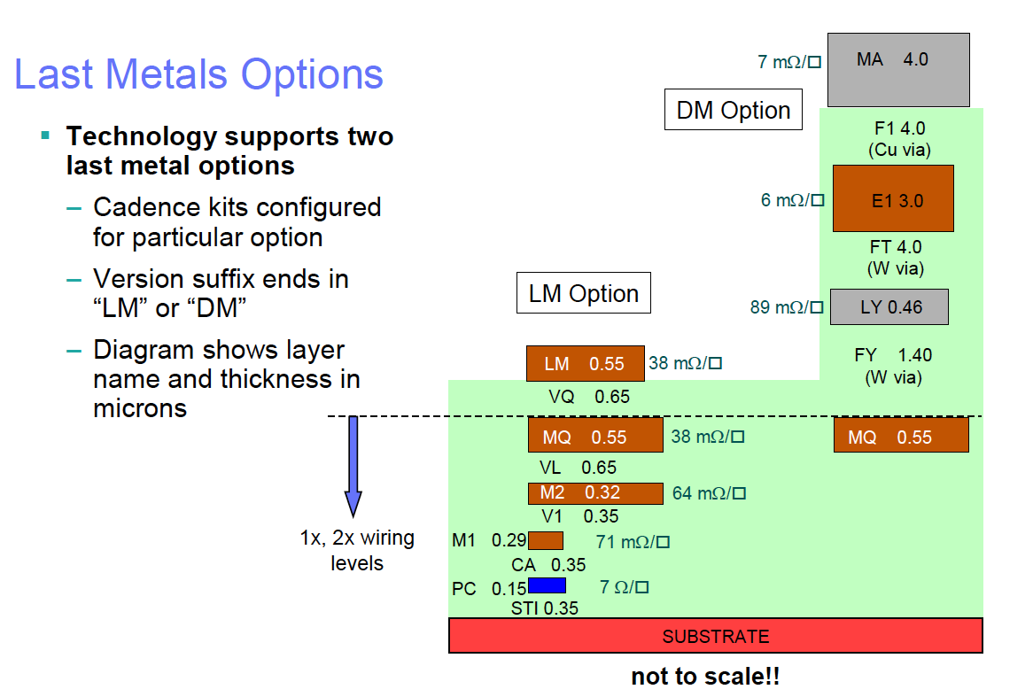
Last metal options

Slide 9
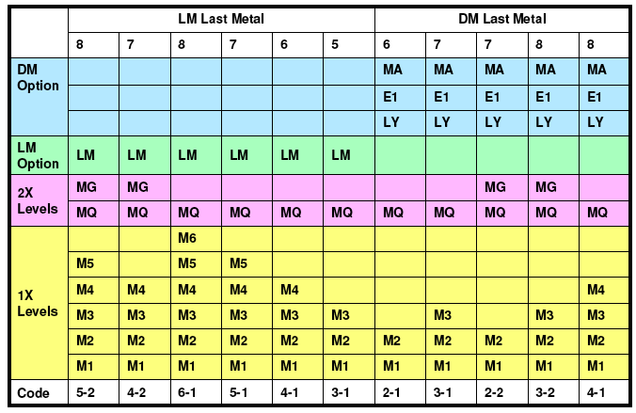
BEOL metallization options
Supported by MOSIS
Dominant choise

Slide 10
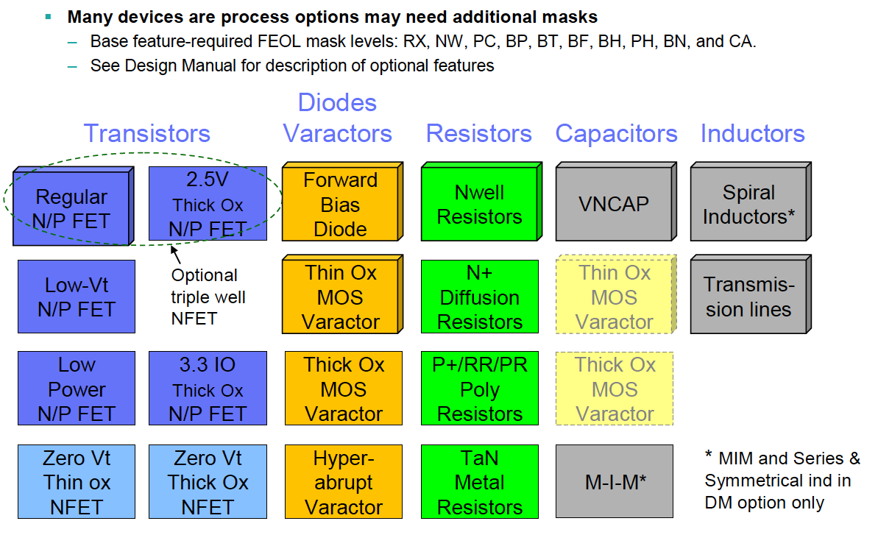
CMOS8RF Devices

Slide 11
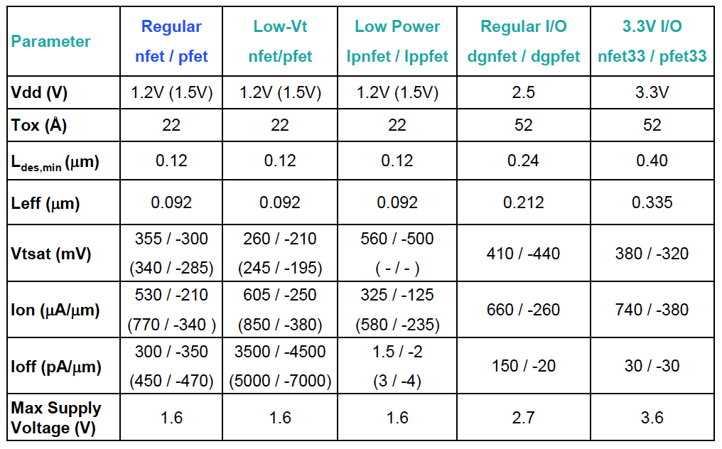
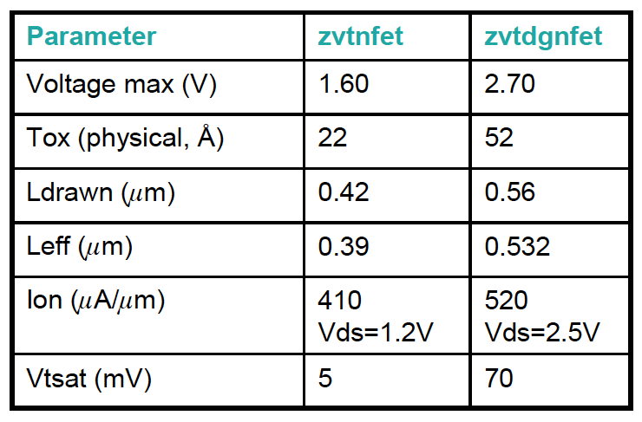
FET devices

Slide 12
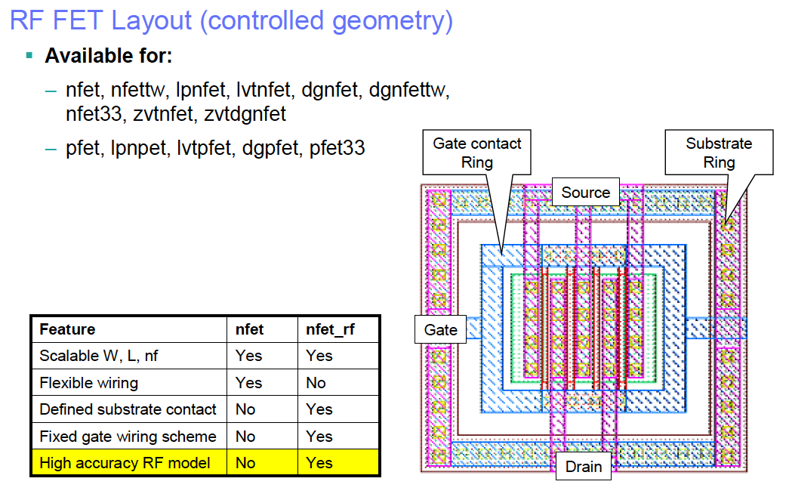
FET Device options

Slide 13
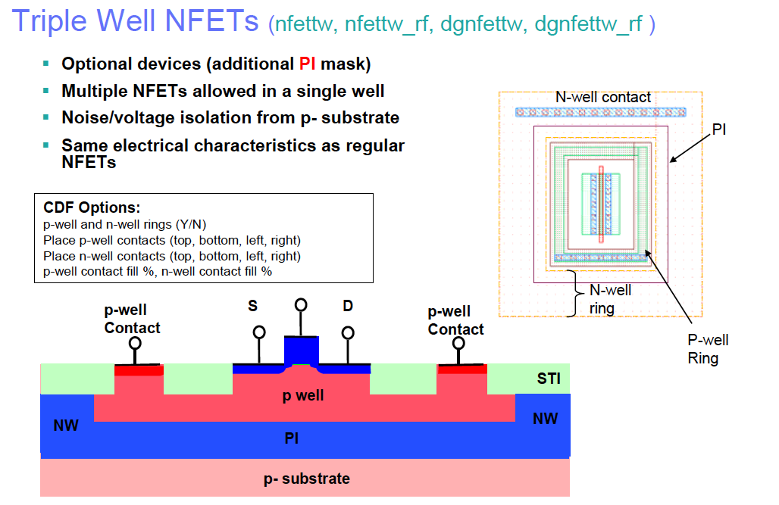
FET Device options
T3 Isolation Well (New feature. Will be fully qualified with the release of the PDK V1.7, Dec.2009)
Enables placement of both NFETs and PFETs in a well isolated form the bulk substrate.
Additional mask level: T3. Zero-Vt devices are not allowed.

Slide 14
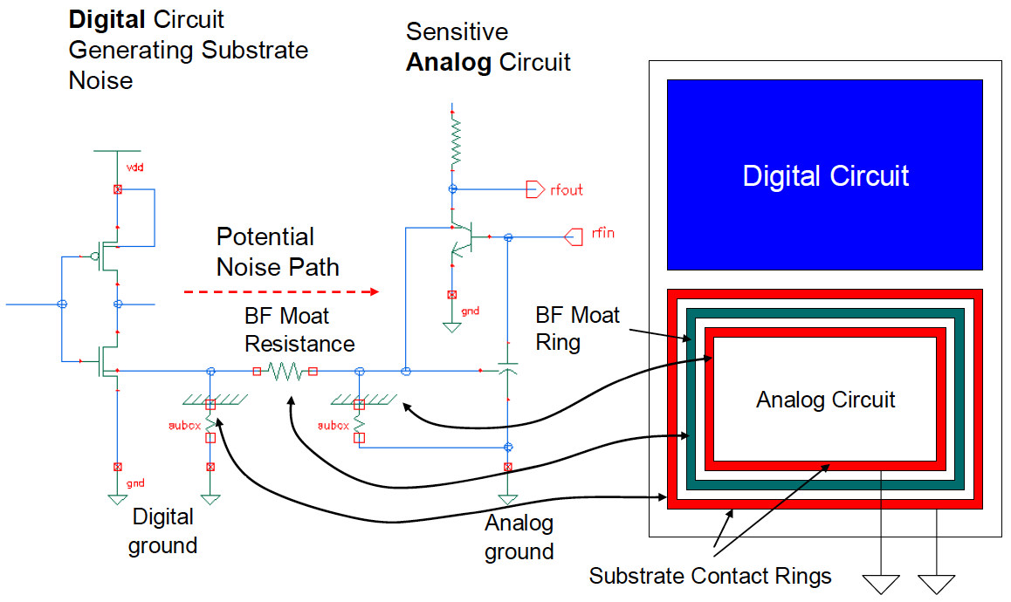
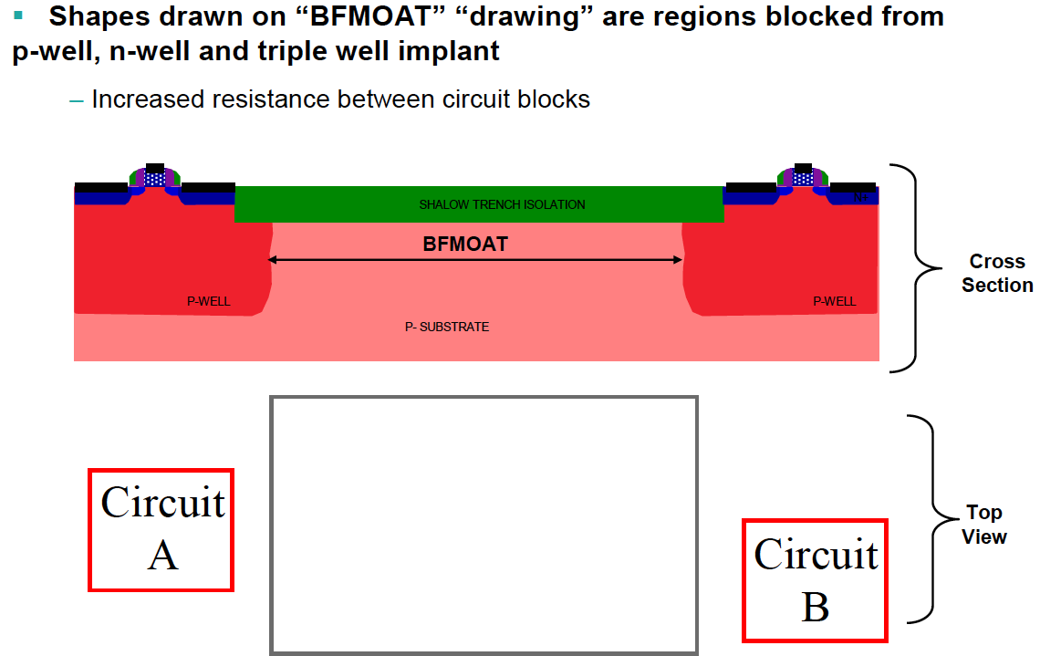
Isolation Structures

Slide 15
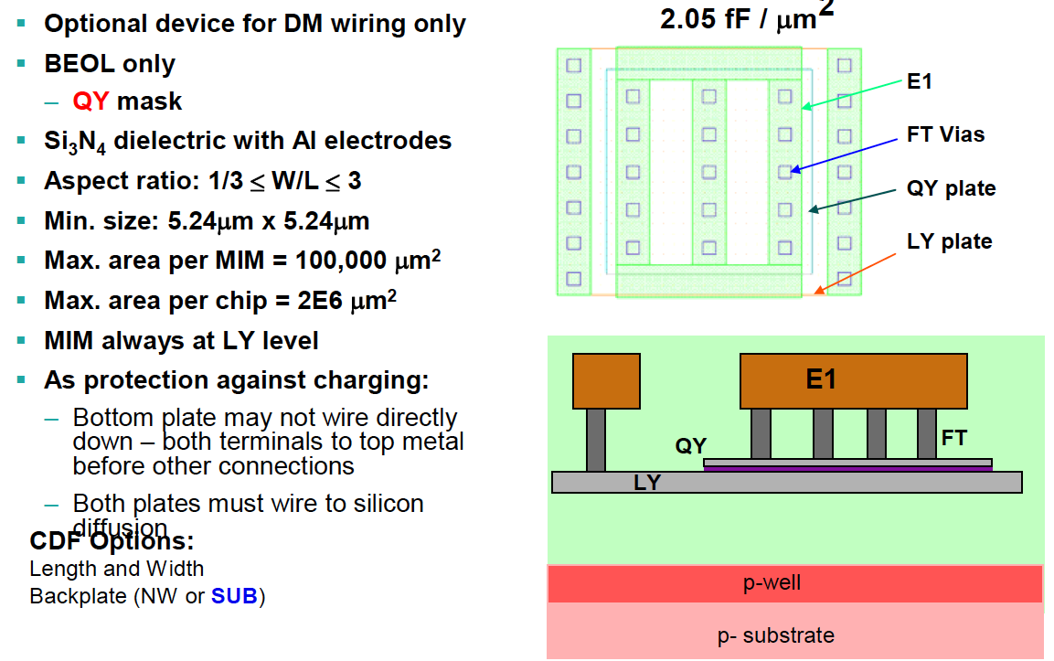
Metal-to-metal Capacitors (mimcap)

Slide 16
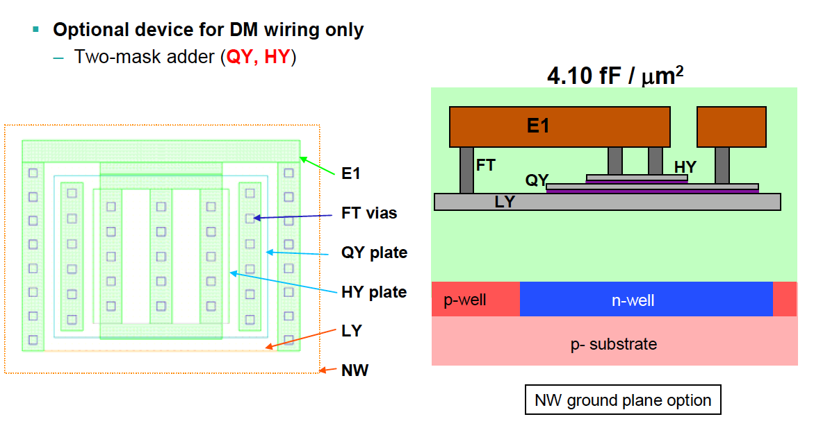
Dual metal-to-metal Capacitors
(dual mimcap)

Slide 17
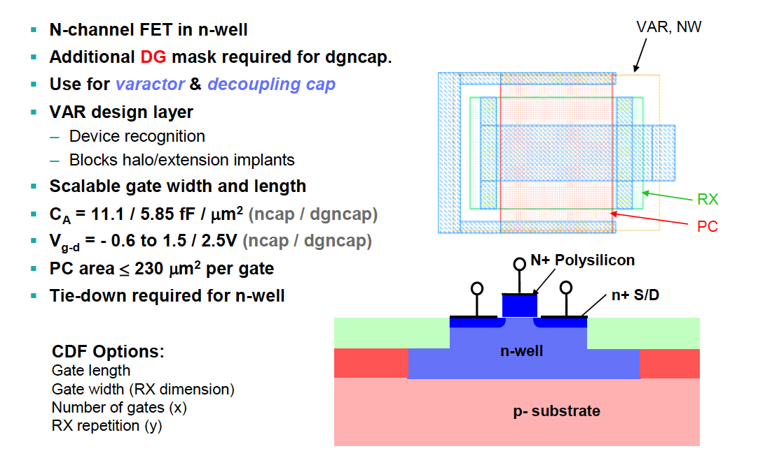
MOS Capacitors (ncap, dgncap)

Slide 18
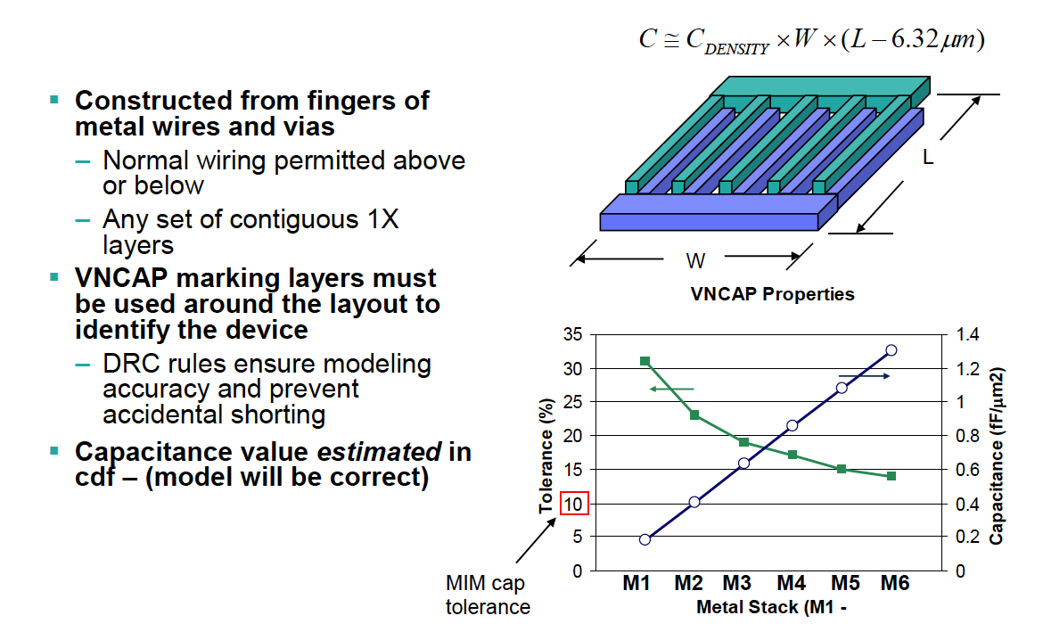
Vertical natural capacitor (vncap)

Slide 19
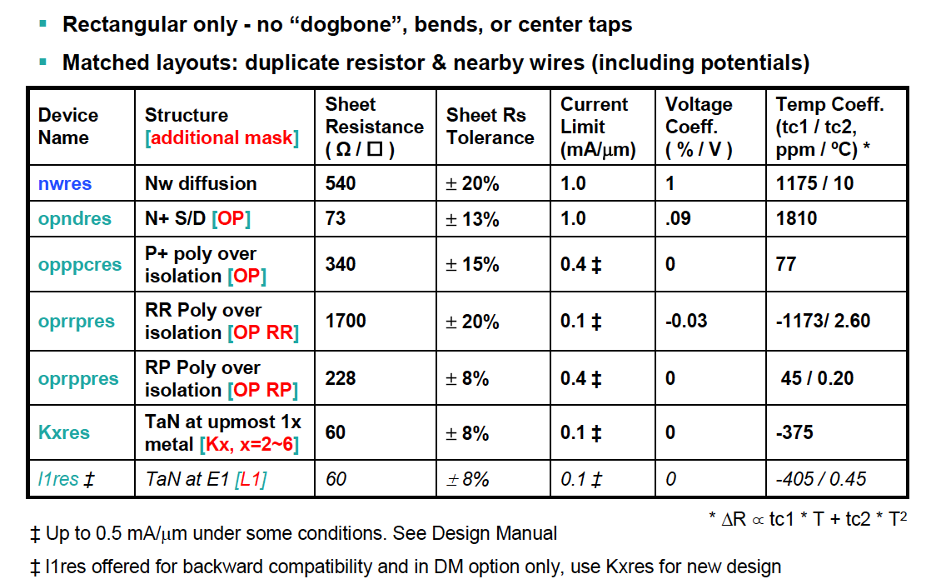
Resistors

Slide 20
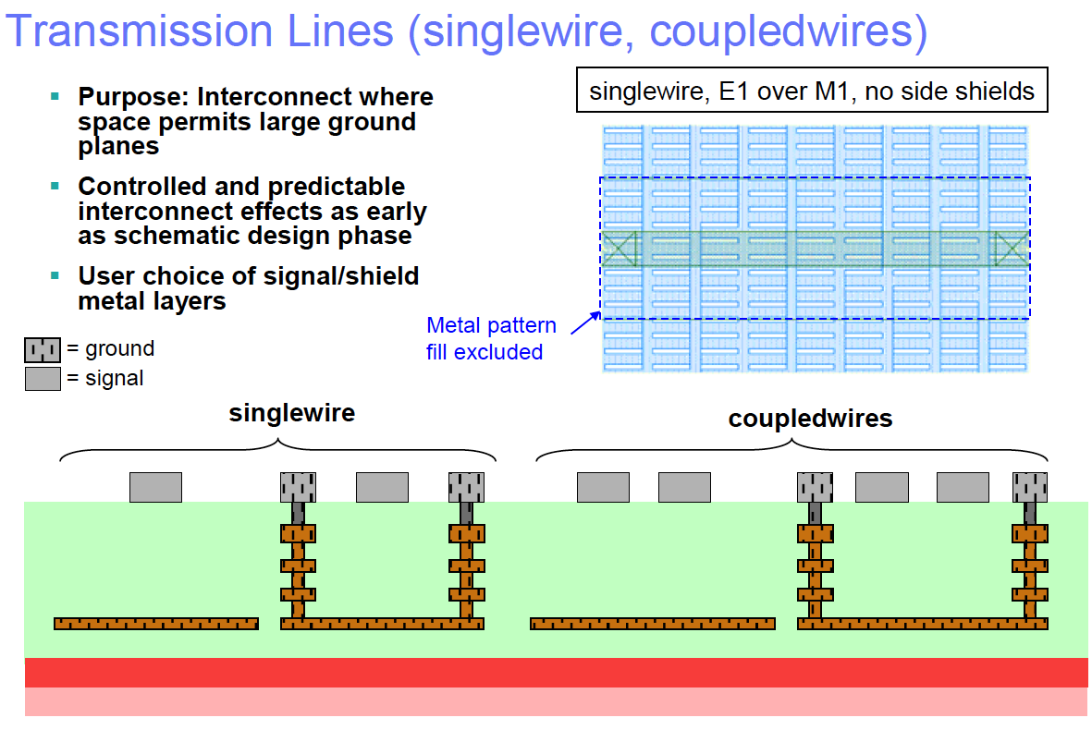
Transmission Lines

Slide 21
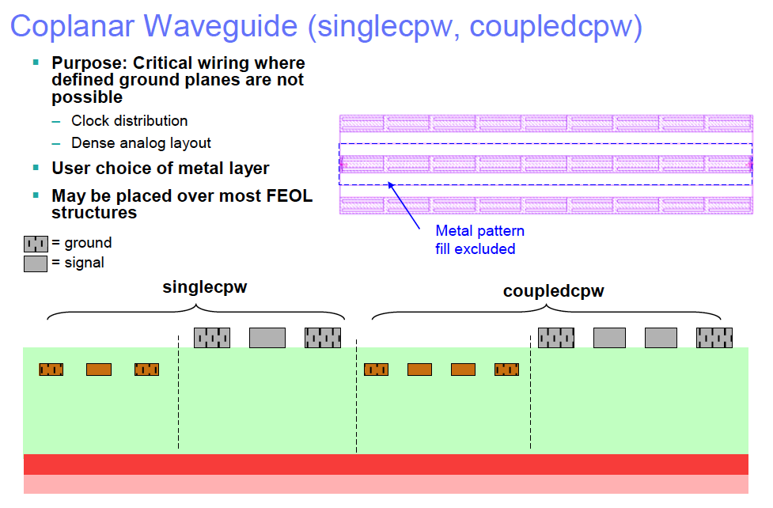
Coplanar Waveguide

Slide 22
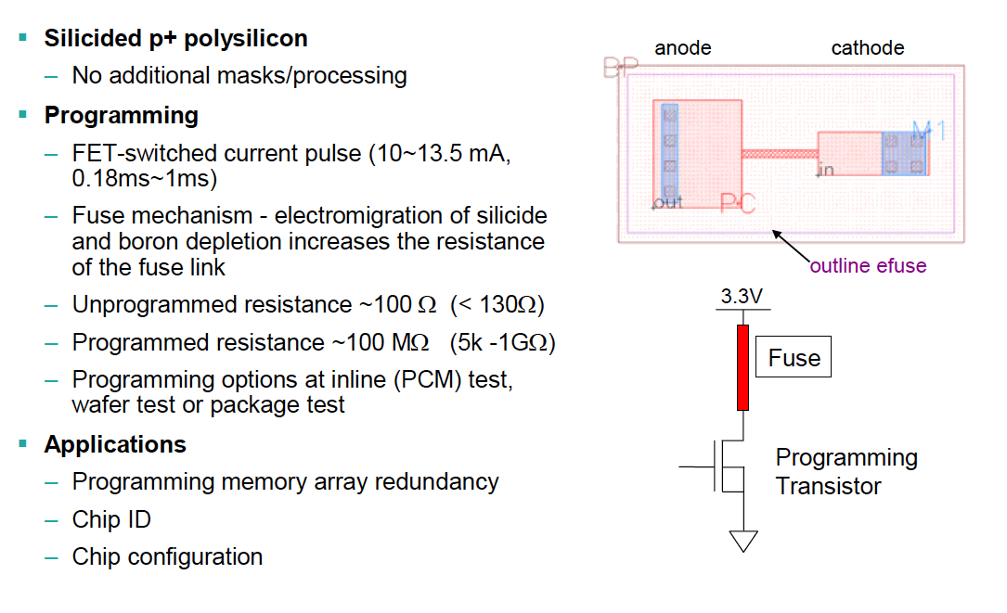
Electronic Fuse (eFuse)

Slide 23
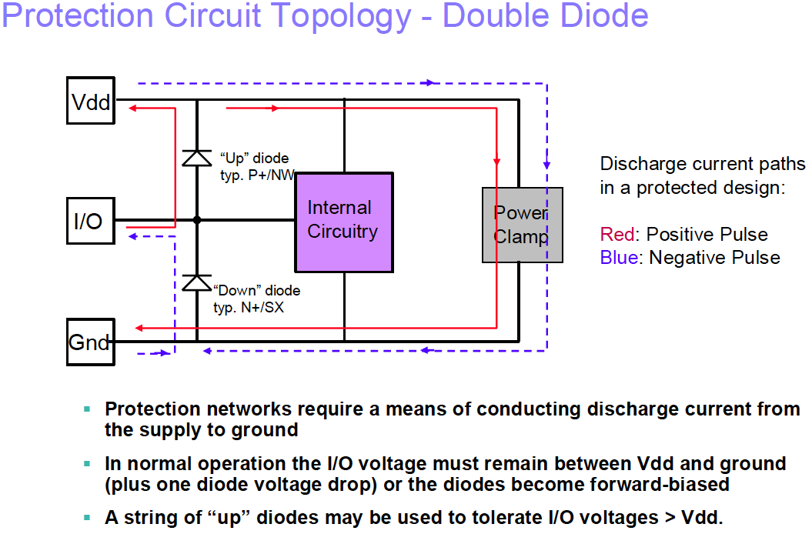
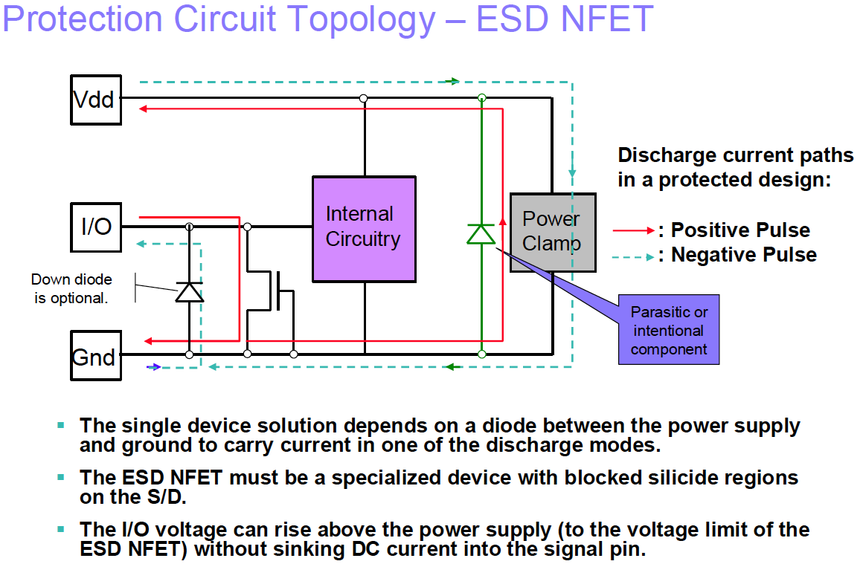
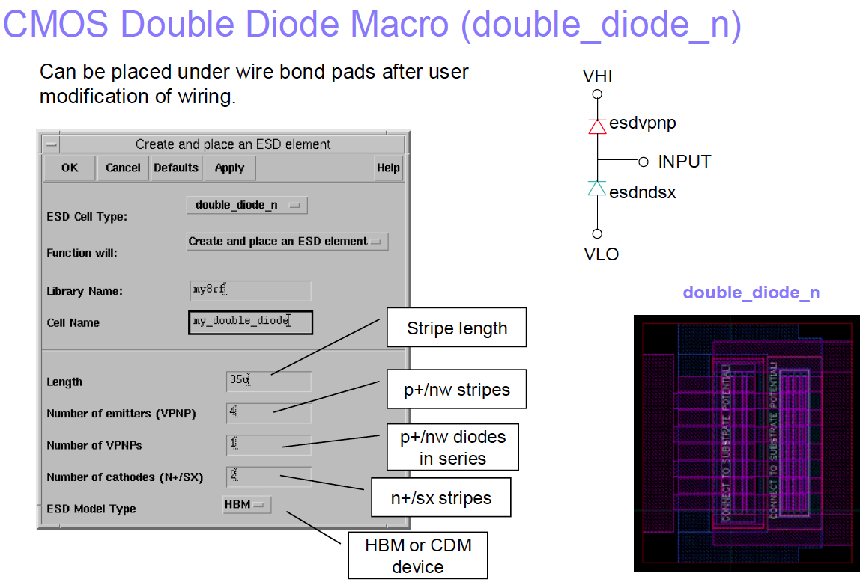
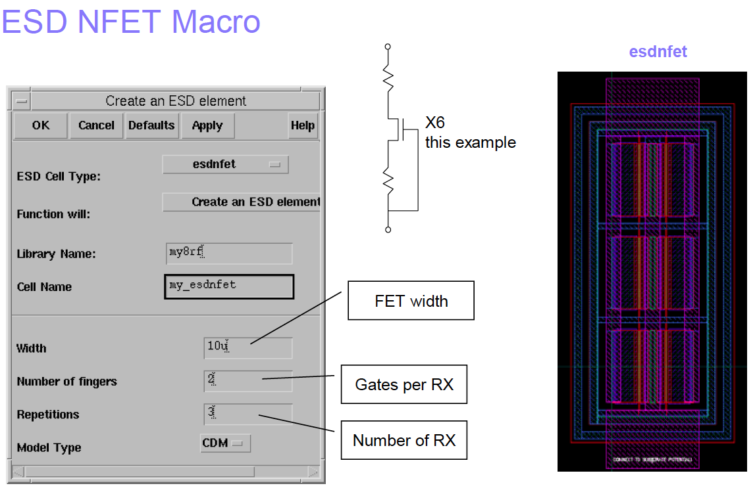
ESD Protection Strategy (1/2)

Slide 24
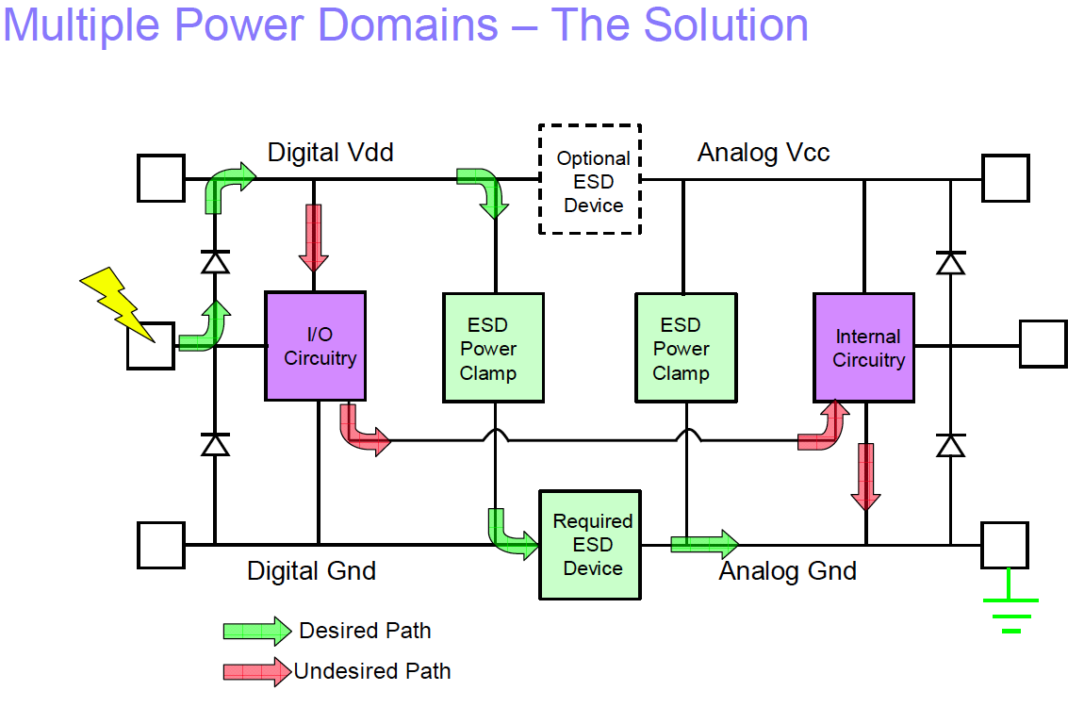
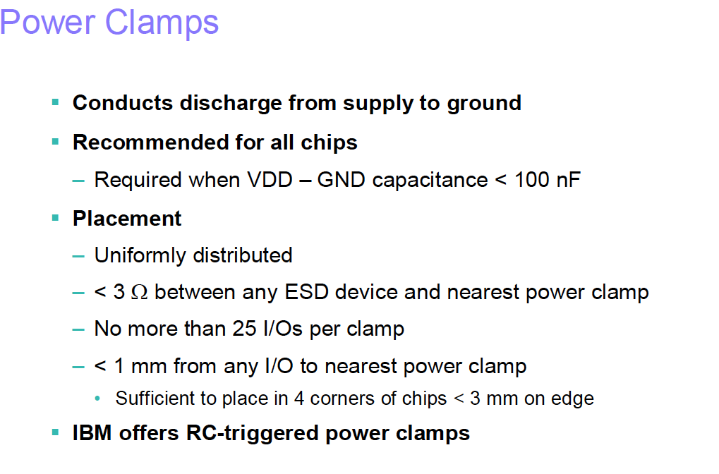
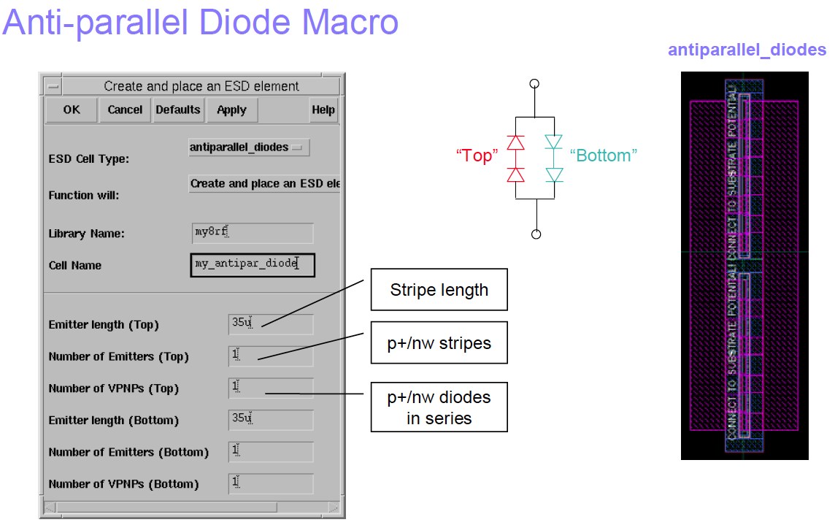
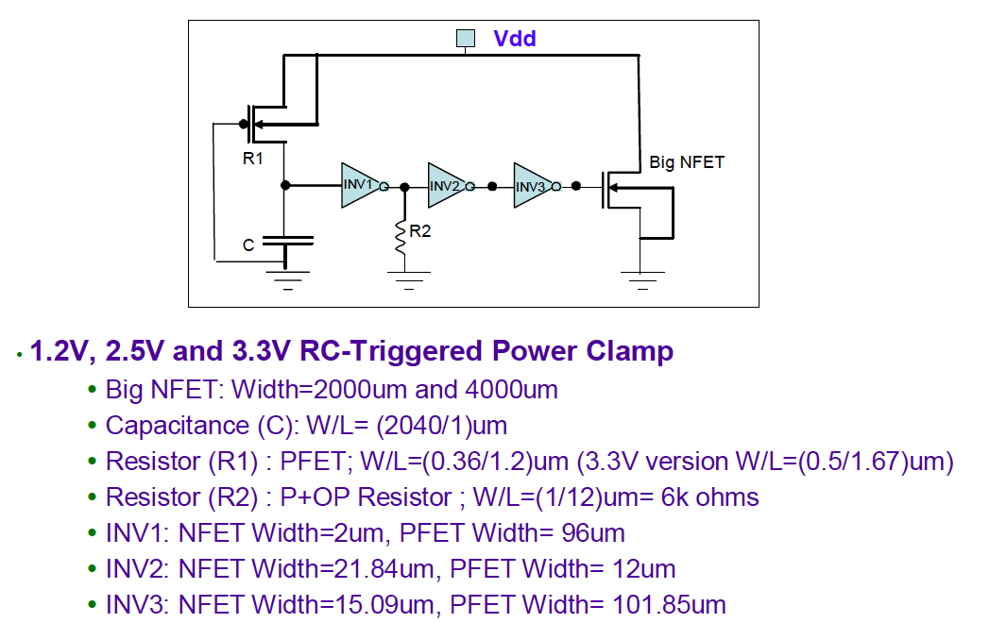
ESD Protection Strategy (2/2)

Slide 25
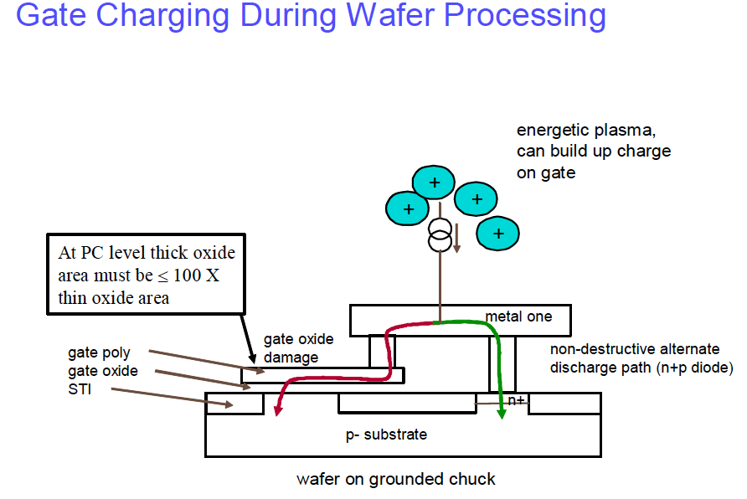
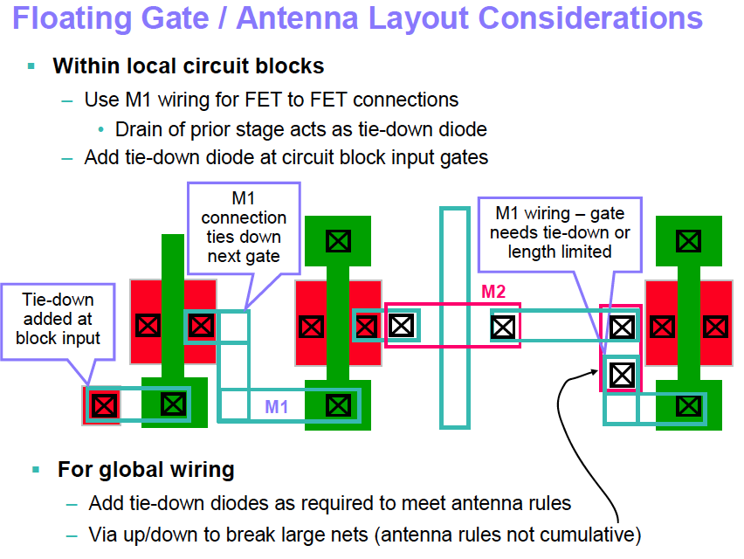
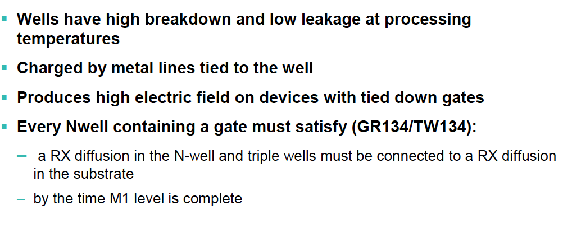
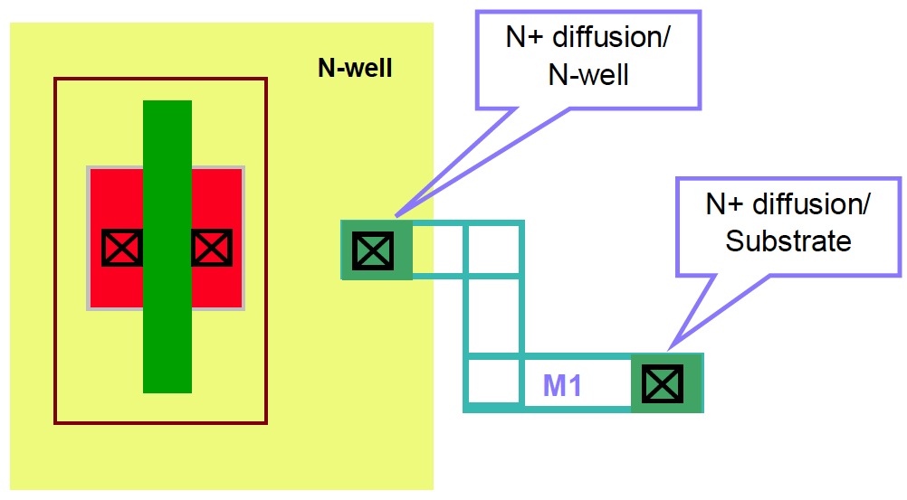
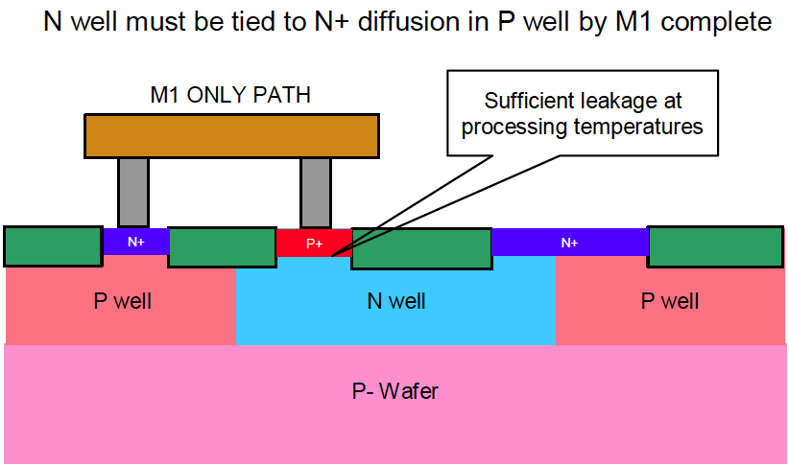
Design For Manufacturability
Floating Gates, Antenna ratios and Tie downs
Nwell and Triple well charging

Slide 26
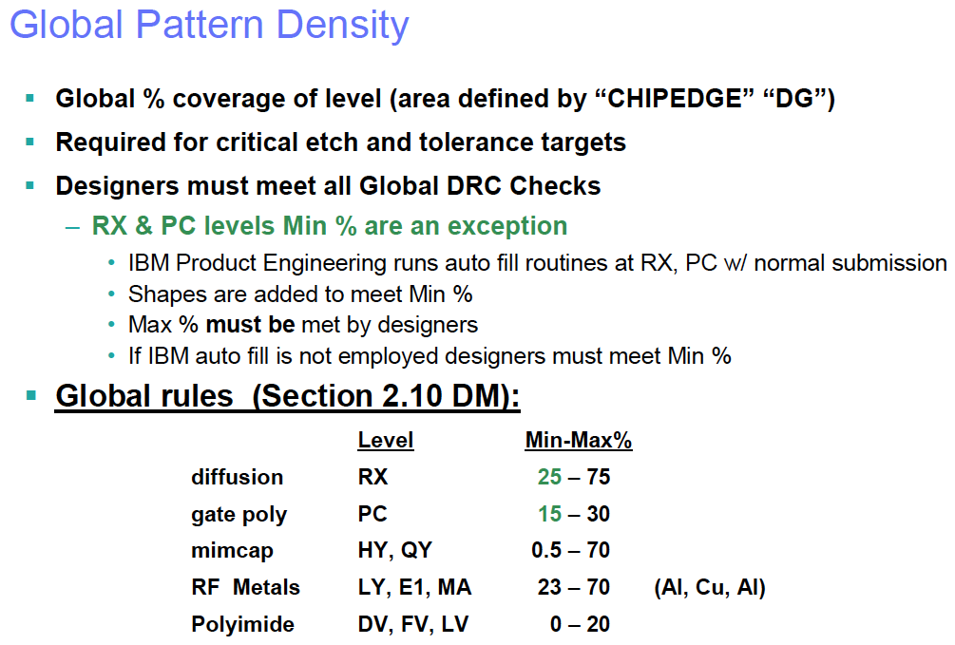
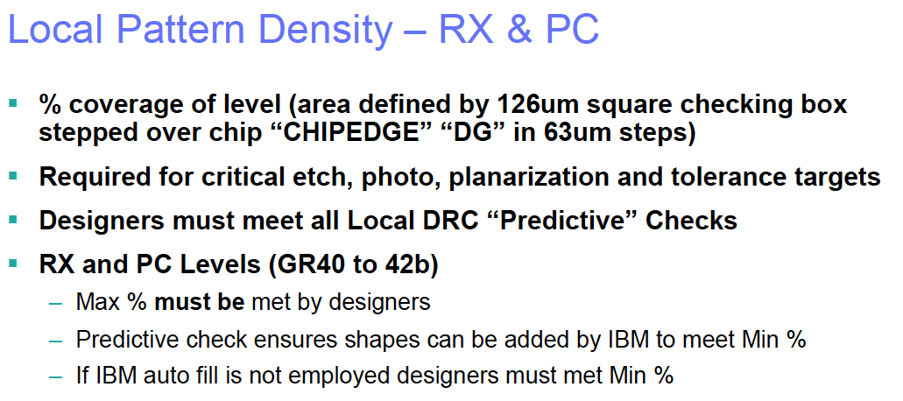
Pattern Density Rules
The Foudry will autofill RX, PC, M1, M2, M3, MQ and MG;
The designer should not attempt to fill any of these layers himself.
The Foundry will NOT autofill the "RF-metals" LY, E1 and MA.
The designer must meet all global,and local, rules for all
three RF-metals.
The cause of many design Tape Out delays!
Early consideration of pattern density rules is essential.

Slide 27
CMOS8WL
(SiGe) 130nm technology

Slide 28
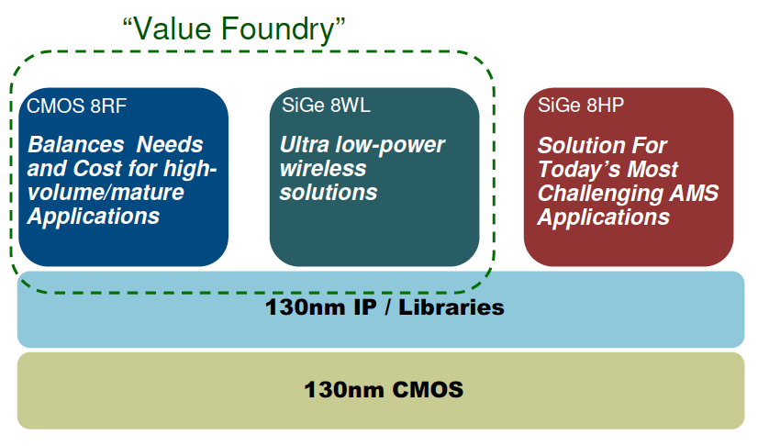
BiCMOS (SiGe) 130nm

Slide 29
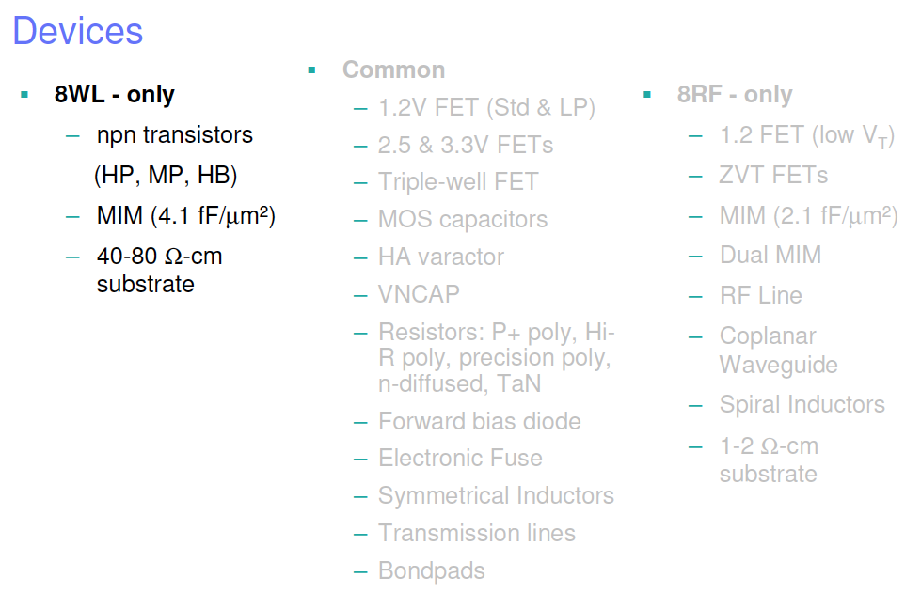
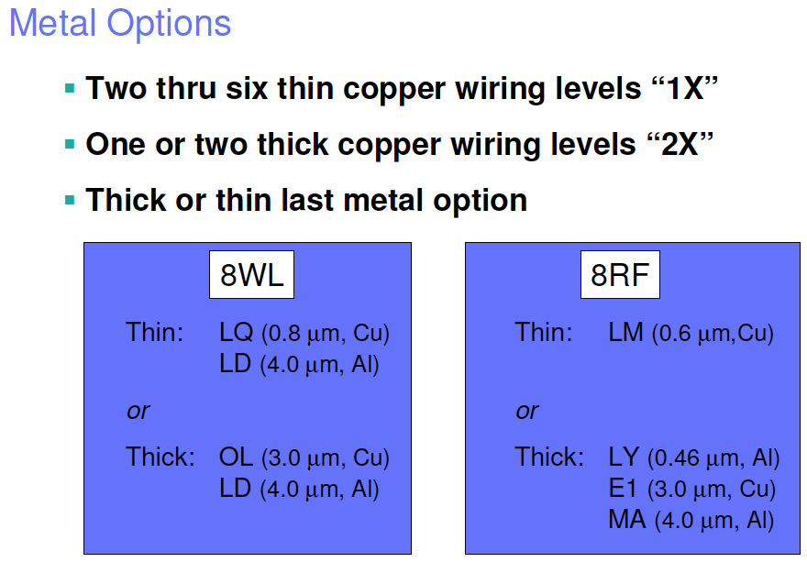
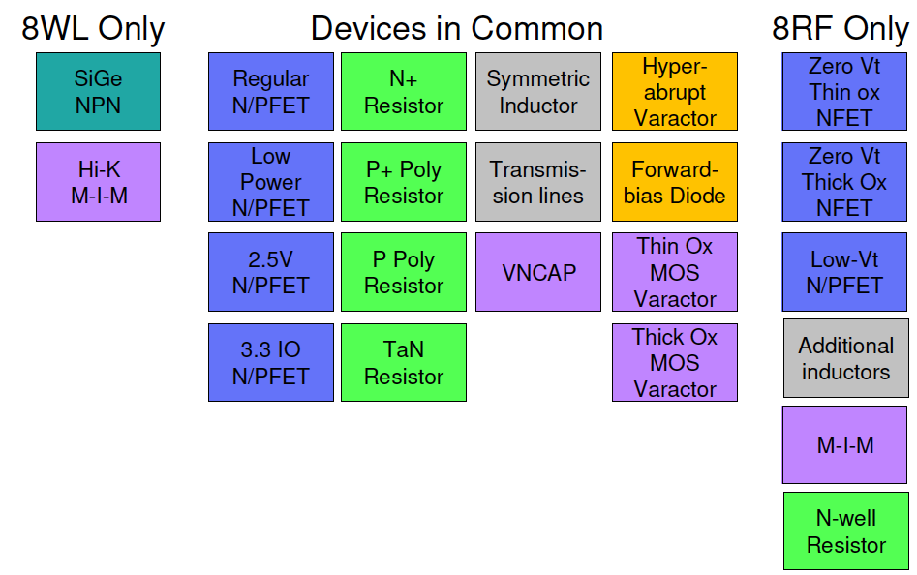
CMOS8WL vs. CMOS8RF
Notes:
High Resistivity substrate
high performance SiGe heterojunction bipolar transistor (HBT)

Slide 30
CMOS9LP/RF
90nm technology

Slide 31
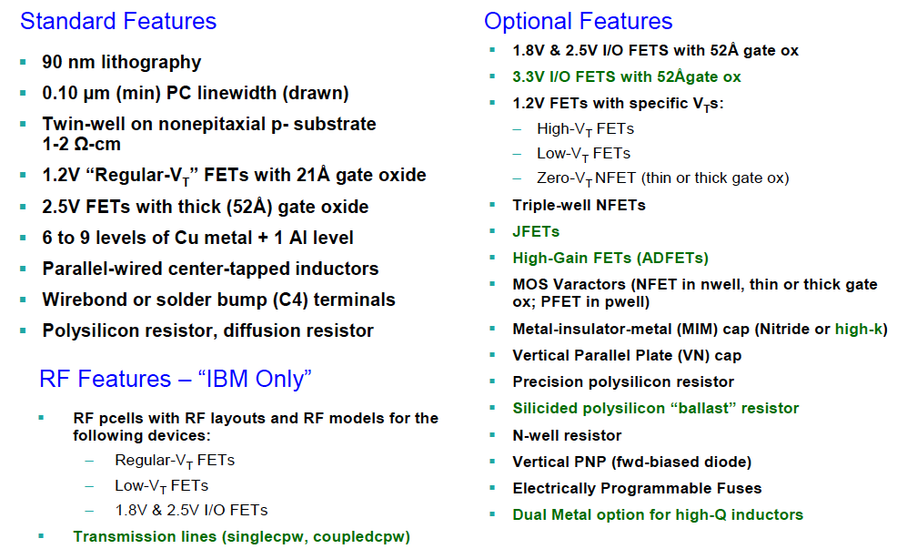
90nm Technology Features
Notes:
Startingwafer is moderately doped p-type with a resistivity of 1-2 Ohm-cm. The technology utilizes a shallow trench isolation
(STI), nominally 0.43 μm deep into the silicon, to provide a dense isolation between FETs and
other devices. All diffusions and polysilicon are silicided for low resistivity unless the silicide
formation is intentionally blocked to form a resistor.

Slide 32
CMOS9 technology derivatives
CMOS 9SF
  Core/IO Voltage: 1.0V/2.5V
  Ideal for leading-edge microprocessors, communications, and computer data processing applications.
CMOS 9LP/RF
  Core/IO Voltage: 1.2V/2.5V
  Use for low-cost, high performance wireless applications, as Bluetooth, WLAN, cellular handsets, mobile TV, WiMax, UWB and GPS.
  THIS IS THE TECHNOLOGY OF OUR CHOISE
  MPW service support

Slide 33
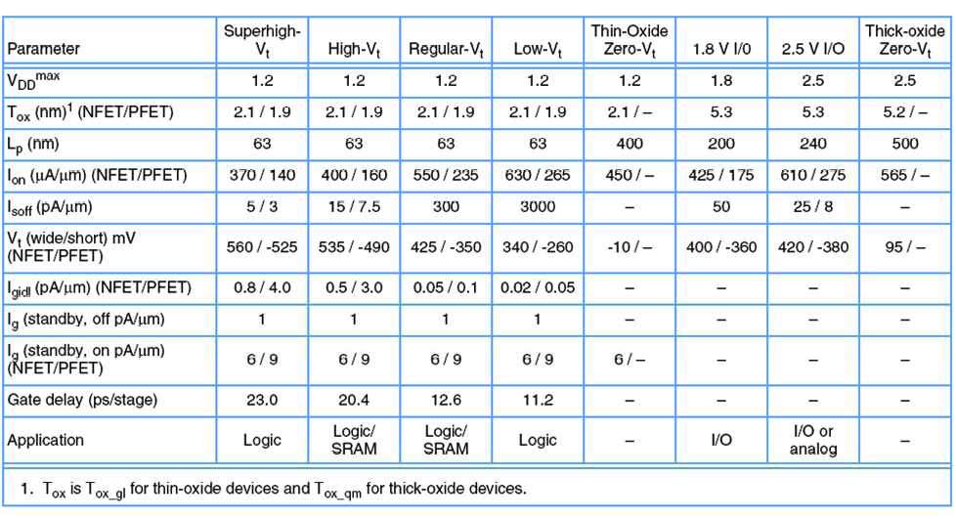
CMOS9LP/RF devices
CMS9FLP/RF offers up to eight NFETs. Six of these (all but the Zero-VT FETs) are available with either dual well or triple well construction.
An optional set of FET pcells is provided for RF applications
Notes:
Ten NFETs are offered. The super-high-VT (svtnfet), high-VT (hvtnfet), regular-VT (nfet), ,
low-VT (lvtnfet), and zero-VT (zvtnfet) all operate at 1.2V, with a nominal gate oxide thickness
of 2.1nm. Separate blocking masks control the channel implants for VT control. The regular-
VT device (nfet) is considered part of the “base” technology, while the other FETs are optional.
At the 90nm technology node, gate oxide leakage currents, as well as sub-threshold off currents,
can be high compared to earlier technology nodes.
Optional high-voltage NFETs (dgvnfet, dgnfet, zvtdgnfet, dgxnfet) are offered for higher-voltage
operation. All four devices are covered by the DG (“Dual Gate”) layer, which results in the thick
oxide.
The dgxnfet, dgvnfet and dgnfet share the same oxide thickness (5.3nm) and doping profiles. A
difference between them is the minimum allowed channel length. The layouts are distinguished
by the presence of the “DG” “v” utility shape on the dgvnfet, to allow design-rule checking of
the gate lengths to different allowed minimum values. The dgxnfet includes the “XE” “dg”
layer.
NFETs may be formed in an isolated pwell, if the isolated pwell feature option is chosen. N3
shape, drawn inside NW shape, forms the isolated pwell. The pcells for isolated-well nfets are
distinguished by “tw” (for “triple well”) in the device name, for example “nfettw.”

Slide 34
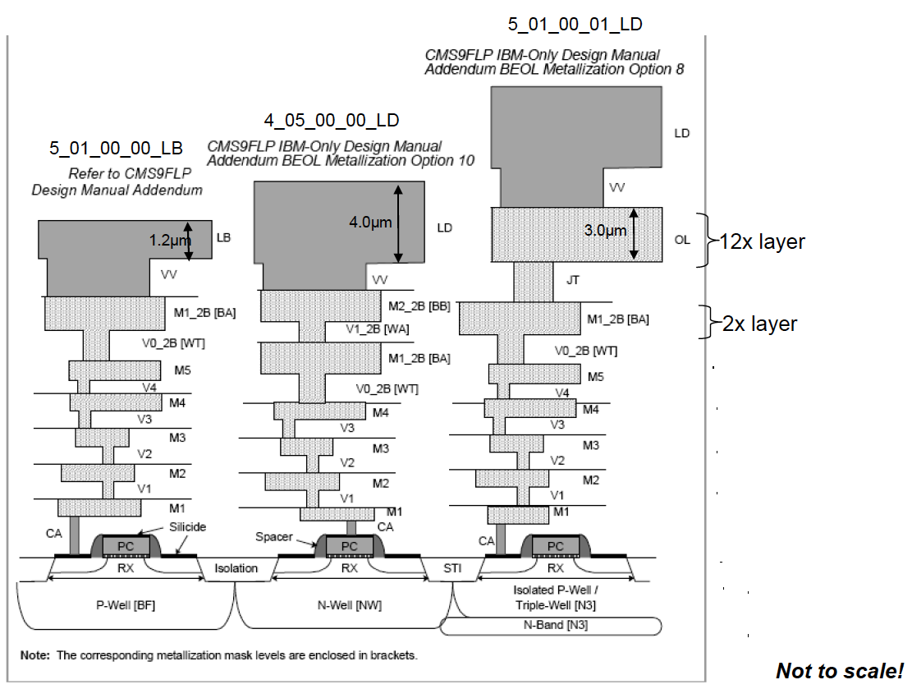
Process Cross-sections
One Aluminum pad metal
Up to 1, 12x-pitch metal on thick oxide
Up to 2, 2x-pitch metals on thick oxide
Up to 6, 1x-pitch metals on low-K dielectric
MPW service supported metal stack
  8 metal stack (M1, M2, M3, M4, M5, M1_2B, OL and LD top-metal to DV (glass cut)

Slide 35
Technology support at CERN
Foundry PDK V1.4 currently available.
  Distributed to a small number of institutes.
Future Plans:
  Investigate options for a digital standard cell library.
  Develop a mixed-signal design kit that supports the same design workflows as for the CMOS8RF.

Slide 36
CMOS8RF
Analog & Mixed Signal Design

Slide 37
Challenges
Technology
  Complex physical design rules and Manufacturability constrains.
  Multiple corners for design simulations.
  Tough Signal Integrity issues, and difficult final Timing Closure.
  Expensive prototyping.
CAE Tools
  Multiplicity of tools and complicated - non linear - design flows.
  Numerous data formats used when interfacing tools from
  different tool vendors.
Designs
  Demanding Power analysis and power management.
  Chip level integration and assembly.
  Large chips require to extend design efforts to multiple teams across geographically distributed institutes.

Slide 38
Requirements
Formalize the methodologies in our design environment.
  Allow designers of the HEP community to become familiar with complex tools, necessary to master large designs in a modern technology.
Assist digital design with an automated workflow.
Common design platform across multiple institutes.
  Enhance team productivity.
Provide a silicon accurate methodology.
  Increase silicon reliability.

Slide 39
Objectives
Development of:
  “Mixed Signal Design Kit”
  “Analog & Mixed Signal Methodologies (Workflows)”
Provide:
  Maintenance
  Training
  Support

Slide 40
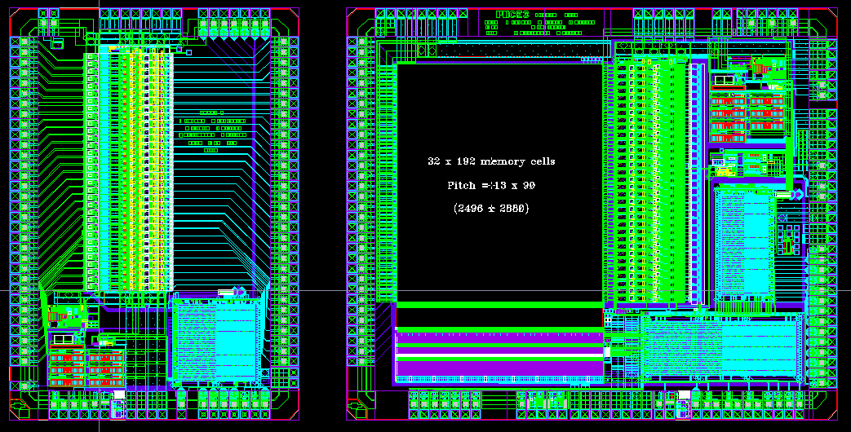
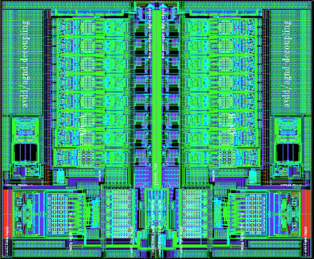
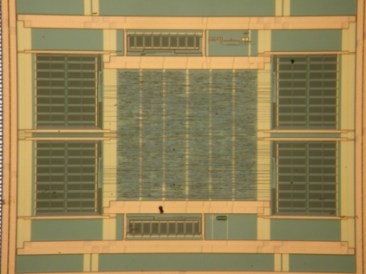
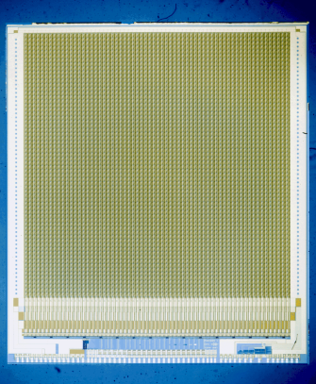
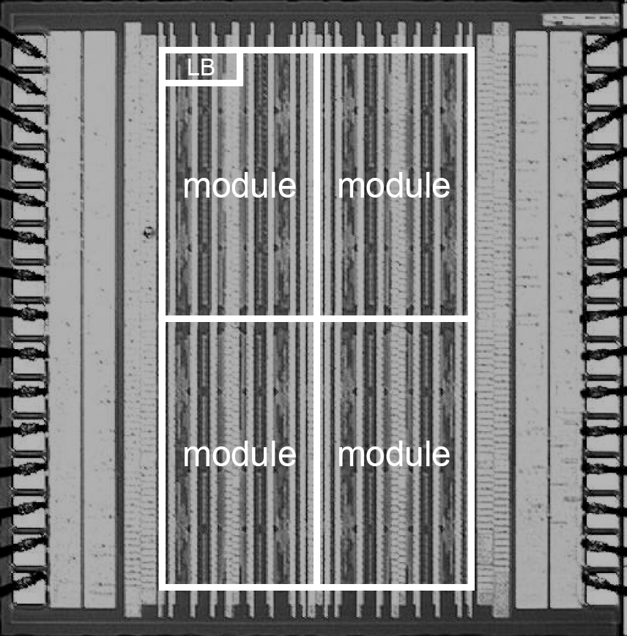
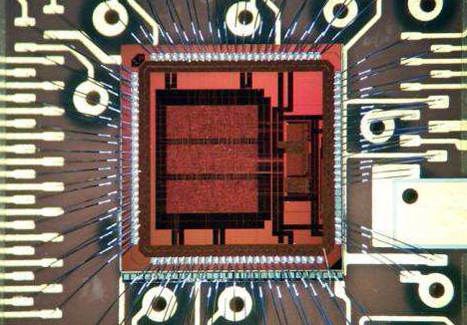
Typical ASIC designs at CERN
128ch pre-amp, analog memory chipset
4ch 40Msps 12-bit ADC
4ch data readout chip
Gigabit Optical Link
MEDIPIX1 Pixel chip
Rad-Tol FPGA
Typical ASIC designs:
  Analog circuits with complex full custom designs
  Mixed Signal with large high performance analog and small digital circuits
  Digital circuits not exceeding 300K gates.

Slide 41
Mixed Signal Design kit
Objectives
  Development of a “Design Kit” for Mixed Signal environments.
    With integrated standard cell libraries.
    Establish well defined Analog & Mixed Signal design workflows.
    Targeted to big “A” (analog), small “D” (digital) ASICs.
    Implemented on modern versions of CAE Tools.
  Replace our previous Design Kit distribution.
    Based on the ARM/ARTISAN cells
    and an automated digital only design flow.
    Making use of old versions of CAE tools.
    Two years in service.
    Already distributed to 25 institutes
    Users can continue using the old design kit and the ARM libraries
    since they have signed NDAs directly with ARM.
    Maintenance and technical support will be provided by ARM.
MR Design kit

Slide 42
Mixed Signal design kit
Key Features:
  PDK V1.6
  Foundry Standard cell and IO pad libraries
    Physical Layout views available.
    Separate substrate contacts
    for mixed signal low noise applications.
    Access to standard cells libraries is legally
    covered by already established Foundry CDAs
  New versions of CAE Tools
    Open Access database support for increased interoperability of Virtuoso and SOC-Encounter environments.
    Compatible with the “Europractice” distributions.
  Support for LINUX Platform (qualified on RHEL4)
PDK
Standard cell libraries
CAE Tools
Mixed Signal Design
Kit
Two independent design kits:
  CMOS8RF-LM (6-2 BEOL)
  CMOS8RF-DM (3-2-3 BEOL)

Slide 43
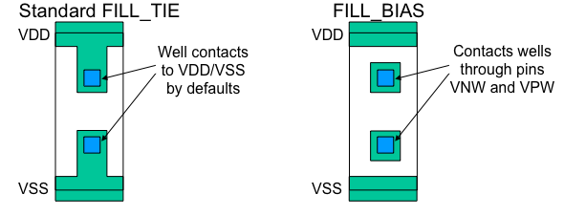
CMOS8RF Core Library
Standard Cell Primitive Logic
AND2 2-Way AND
AND3 3-Way AND
AND4 4-Way AND
INVERT Inverter
INVERTBAL Balanced Inverter
NAND2 2-Way NAND
NAND2BAL Balanced 2-Way NAND
NAND3 3-Way NAND
NAND4 4-Way NAND
NOR2 2-Way NOR
NOR3 3-Way NOR
NOR4 4-Way NOR
OR2 2-Way OR
OR3 3-Way OR
OR4 4-Way OR
XOR2 2-Way XOR
XOR3 3-Way XOR
XOR8 8-Way XOR (8-Bit Parity Odd)
XOR9 9-Way XOR (9-Bit Parity Odd)
XNOR2 2-Way XNOR
XNOR3 3-Way XNOR
Standard Cell Complex Logic
AO21 2x1 AND OR
AO22 2x2 AND OR
AO33 3x3 AND OR
AO44 4x4 AND OR
AO222 2x2x2 AND OR
AO2222 2x2x2x2 AND OR
AOI21 2x1 AND OR Invert
AOI22 2x2 AND OR Invert
AOI33 3x3 AND OR Invert
AOI44 4x4 AND OR Invert
AOI222 2x2x2 AND OR Invert
AOI2222 2x2x2x2 AND OR Invert
OA21 2x1 OR AND
OA22 2x2 OR AND
OA222 2x2x2 OR AND
OA2222 2x2x2x2 OR
OAI21 2x1 OR AND Invert
OAI22 2x2 OR AND Invert
OAI222 2x2x2 OR AND Invert
OAI2222 2x2x2x2 OR AND Invert
Standard Cell Unique Logic
ADDF Full Adder
BUFFER Buffer
CLK Clock Driver
CLKI Inverting Clock Driver
COMP2 2-Bit Comparator
DECAP VDD–GND Decoupling Capacitor
DELAY4 Delay Line
DELAY6 Delay Line
MUX21 2:1 Multiplexer
MUX21BAL Balanced 2:1 Multiplexer
MUX21I 2:1 Multiplexer w/Inverted Output
MUX41 4:1 Multiplexer
TERM Net Terminator
Standard Cell Sequential Latches
DFF D Flip-Flop, Q and QBAR Outputs.
DFFR D Flip-Flop, Q and QBAR Outputs, -Asyn Reset
DFFS D Flip-Flop, Q and QBAR Outputs, Asyn Set
DFFSR D Flip-Flop, Q and QBAR Outputs, Asyn Set, -Asyn Reset
LATSR Latch w/Q and QBAR Outputs, Asyn Set, -Asyn Reset
SDFF Scannable D Flip-Flop, Q and QBAR Outputs
SDFFR Scannable D Flip-Flop, Q and QBAR Outputs, -Asyn Reset
SDFFS Scannable D Flip-Flop, Q and QBAR Outputs, Asyn Set
SDFFSR Scannable D Flip-Flop, Q and QBAR Outputs, Asyn Set, -Asyn Reset
SLATSR Scannable Latch w/Q and QBAR Outputs, Asyn Set, -Asyn Reset
Physical Design Cells
FILL1, FILL2 One and Two Cell Post-Fill Cells
FGTIE_G Floating Gate Tie-Off
GAUNUSEDxxx Gate Array Post-Fill Cells
NWSX N-Well/Substrate Tie-Off Cell
7 driving strength derivatives / cell

Slide 44
CMOS8RF IO pad Library
Standard Cell I/Os
BC1520, BC1520_PM 1.5 V CMOS Nontest 20 Ohm 3-State I/O
BC1535, BC1535_PM 1.5 V CMOS Nontest 35 Ohm 3-State I/O
BC1550, BC1550_PM 1.5 V CMOS Nontest 50 Ohm 3-State I/O
BC1565, BC1565_PM 1.5 V CMOS Nontest 65 Ohm 3-State I/O
BC1590, BC1590_PM 1.5 V CMOS Nontest 90 Ohm 3-State I/O
BC1520PD, BC1520PD_PM 1.5 V CMOS Nontest 20 Ohm 3-State I/O w/Pull-Down
BC1535PD, BC1535PD_PM 1.5 V CMOS Nontest 35 Ohm 3-State I/O w/Pull-Down
BC1550PD, BC1550PD_PM 1.5 V CMOS Nontest 50 Ohm 3-State I/O w/Pull-Down
BC1565PD, BC1565PD_PM 1.5 V CMOS Nontest 65 Ohm 3-State I/O w/Pull-Down
BC1590PD, BC1590PD_PM 1.5 V CMOS Nontest 90 Ohm 3-State I/O w/Pull-Down
BC1520PU, BC1520PU_PM 1.5 V CMOS Nontest 20 Ohm 3-State I/O w/Pull-Up
BC1535PU, BC1535PU_PM 1.5 V CMOS Nontest 35 Ohm 3-State I/O w/Pull-Up
BC1550PU, BC1550PU_PM 1.5 V CMOS Nontest 50 Ohm 3-State I/O w/Pull-Up
BC1565PU, BC1565PU_PM 1.5 V CMOS Nontest 65 Ohm 3-State I/O w/Pull-Up
BC1590PU, BC1590PU_PM 1.5 V CMOS Nontest 90 Ohm 3-State I/O w/Pull-Up
BC1820, BC1820_PM 1.8 V CMOS Nontest 20 Ohm 3-State I/O
BC1835, BC1835_PM 1.8 V CMOS Nontest 35 Ohm 3-State I/O
BC1850, BC1850_PM 1.8 V CMOS Nontest 50 Ohm 3-State I/O
BC1865, BC1865_PM 1.8 V CMOS Nontest 65 Ohm 3-State I/O
BC1820PD, BC1820PD_PM 1.8 V CMOS Nontest 20 Ohm 3-State I/O w/Pull-Down
BC1835PD, BC1835PD_PM 1.8 V CMOS Nontest 35 Ohm 3-State I/O w/Pull-Down
BC1850PD, BC1850PD_PM 1.8 V CMOS Nontest 50 Ohm 3-State I/O w/Pull-Down
BC1865PD, BC1865PD_PM 1.8 V CMOS Nontest 65 Ohm 3-State I/O w/Pull-Down
BC1820PU, BC1820PU_PM 1.8 V CMOS Nontest 20 Ohm 3-State I/O w/Pull-Up
BC1835PU, BC1835PU_PM 1.8 V CMOS Nontest 35 Ohm 3-State I/O w/Pull-Up
BC1850PU, BC1850PU_PM 1.8 V CMOS Nontest 50 Ohm 3-State I/O w/Pull-Up
BC1865PU, BC1865PU_PM 1.8 V CMOS Nontest 65 Ohm 3-State I/O w/Pull-Up
BC2520, BC2520_PM 2.5 V CMOS Nontest 20 Ohm 3-State I/O
BC2535, BC2535_PM 2.5 V CMOS Nontest 35 Ohm 3-State I/O
BC2550, BC2550_PM 2.5 V CMOS Nontest 50 Ohm 3-State I/O
BC2565, BC2565_PM 2.5 V CMOS Nontest 65 Ohm 3-State I/O
BC2590, BC2590_PM 2.5 V CMOS Nontest 90 Ohm 3-State I/O
BC2520PD, BC2520PD_PM 2.5 V CMOS Nontest 20 Ohm 3-State I/O w/Pull-Down
BC2535PD, BC2535PD_PM 2.5 V CMOS Nontest 35 Ohm 3-State I/O w/Pull-Down
BC2550PD, BC2550PD_PM 2.5 V CMOS Nontest 50 Ohm 3-State I/O w/Pull-Down
BC2565PD, BC2565PD_PM 2.5 V CMOS Nontest 65 Ohm 3-State I/O w/Pull-Down
BC2590PD, BC2590PD_PM 2.5 V CMOS Nontest 90 Ohm 3-State I/O w/Pull-Down
BC2520PU, BC2520PU_PM 2.5 V CMOS Nontest 20 Ohm 3-State I/O w/Pull-Up
BC2535PU, BC2535PU_PM 2.5 V CMOS Nontest 35 Ohm 3-State I/O w/Pull-Up
BC2550PU, BC2550PU_PM 2.5 V CMOS Nontest 50 Ohm 3-State I/O w/Pull-Up
BC2565PU, BC2565PU_PM 2.5 V CMOS Nontest 65 Ohm 3-State I/O w/Pull-Up
BC2590PU, BC2590PU_PM 2.5 V CMOS Nontest 90 Ohm 3-State I/O w/Pull-Up
Standard Cell C4 I/Os for LM (BEOL) option
Standard Cell Power Supply pads

Slide 45
CMOS8RF Mixed Signal Workflows
Analog & Mixed Signal (AMS) Workflows.
  Standardized, validated Design Workflows
  Top-down design Partitioning.
  Digital Block implementation flow
  Mixed-Signal Simulation & design Concept Validation
  Hierarchical design Floorplaning and Physical Assembly
  Design Performance Validation and Physical Verification
CERN – VCAD Cadence - Foundry collaboration
  VCAD brought in their invaluable expertise on the CAE tools
  Foundry provided the physical IP blocks and important technical assistance.
  CERN assists the development and validates the design kit functionality

Slide 46

Analog & Mixed Signal Flows
Analog Driven (Analog on Top) design workflow
Top-Down Functional Design
Early chip level verification strategy has to be in place and validated with correct partitioning between analog and digital.
As the project is proceeding toward completion, the same top-level validation is done by replacing the behavioural model with a transistor-level description (including RC parasitic if required).
Top-Down Physical Design
Early floorplanning (including pad placement) even with rough estimation of block (area, aspect ratio, pin location) will enable to plan for special nets routing (buses, clocks, power network, sensitive nets ...).
As the project is proceeding toward completion, the same floorplanning could be refined and adapted.
Bottom-up Block Function
& Physical Design
Analog and Digital block circuit level implementation (transistors & gates)
The Concept
The use of the workflows may vary depending on
the design requirements and organization of design teams.

Slide 47
CAE Design Tools
Workflows are based mainly on Cadence tools
  All versions are compatible with the Europractice 2008-2009 distribution
Description | Tool Version
Analog and Mixed Signal environment & custom layout generation | IC 6.1.3 OA (Open Access)
Analog Simulation Tools | MMSIM 7.01.091
Encounter, semicustom implementation tools | SOC 7.1 ETS 7.1
Digital simulation and verification | IUS 8.10.006
Logical equivalence checking and clock domain crossing checks | CONFRML 7.2
QRC Extraction | EXT 7.12.000
Physical Verification | ASSURA 3.2OA_612 CALIBRE 2008_3_25

Slide 48
Design Kit Distribution
The Design kit will be made available to collaborating institutes.
  No access fees required.
  Pay-per-use scheme.
    Prototyping should be done through CERN
    A small fee will be applied.
    This should cover part of the design kit maintenance costs in the long term.
  Planned for release in October 2009.
  Announcement by e-mail to the “130nm user list”.
Acquiring the CMOS8RF Mixed Signal Design Kit
  Contact Bert.Van.Koningsveld@cern.ch
  or Kostas.Kloukinas@cern.ch
  Establish a CDA with Foundry (if not already in place).
  Granted access to the CERN ASIC support web site.

Slide 49

The CERN ASIC support website
http://cern.ch/asic-support
Download Design Kits and
access technical documents
(restricted access)
Information about MPW runs
and foundry access services.
Communicate news and
User support feedback forms
and access request forms.
This website replaces our ‘afs’ based download facility.

Slide 50
User Support and Training
Maintenance
  Distribution of:
    PDK updates.
    Design Flow updates and enhancements.
    Updates to accommodate new releases of CAE tools.
User Support
  Limited to the distributed Design Kit version,
  under the supported versions of the CAE design tools.
Training sessions
  Scheduled sessions:
    1st session: 26 to 30 October (CERN internal)
    2nd session: 16 to 20 November (open to external engineers)
    3rd session: 30 Nov to 4 December (outside CERN)

Slide 51
Training Session contents
Day 1
CDB IP Import to OA database for IC61 Methodology
Concept Validation (Mixed Signal Behavioral Simulations)
Day 2
Constraint Driven Analog Block Creation
Electrical Parameters Optimization Over Process Variations
Block IP Characterization Front End (Create analog behavioral model)
Day 3
Functional Verification (Mixed Signal, transistor/gate level Simulations)
Block IP Characterization Back End (Abstract view generation)
Day 4
Hierarchical Floorplaning (Virtuoso based)
DRC (Calibre + Assura workflows)
LVS (Callibre + Assura workflows)
Extraction
Day 5
Digital Block Implementation
Digital IP Characterization
Preliminary

Slide 52
Access to Technology Data
Distributed by CERN
Technology | Process | Distributable
CMOS8RF-LM | 130nm
CMOS8RF-DM | 130nm
BiCMOS8WL | 130nm (SiGe)
BiCMOS8HP | 130nm (SiGe)
CMOS9SF | 90nm
PDK
Design Kit
PDK
Design Kit
PDK
PDK
PDK
: Physical Design Kit for Analog full custom design.
: Design Kit that supports Analog & Mixed Signal designs.
PDK
Design Kit

Slide 53
Future Plans
Extend the functionalities of the CMOS8RF (130nm) kit.
  Next Release scheduled for late February 2010
    Integrates PDK V1.7.0
    Implements bug fixes as reported by users.
Development of a Design Kit for the CMOS9LP/RF (90nm)
  Standard cell libraries
  Design Workflows similar to those in the CMOS8RF Design Kit.

Slide 54
Digital Block Implementation Flow
Prepared by
Sandro Bonacini
CERN PH/ESE
sandro.bonacini@cern.ch

Slide 55
Motivation
Implementation of digital blocks
  for small (~300 kgate) logic cores
  for “pure” digital or mixed signal ASICs
Using the 130 nm standard cell library
  Separate substrate/ground and n-well/VDD biasing for mixed signal designs
Defined methodology compatible with mixed signal design flows
  Open Access based

Slide 56

Virtuoso Digital Implementation flow
Compatible with “Analog on Top” Design Flow

Slide 57
Digital Design Flow
Automated task
RTL synthesis
Timing optimization
User task
Logical Equivalence Checking
Logical Equivalence Checking
Clock tree synthesis
DFM
Floorplanning
& power routing
Timing optimization
Signoff
RC extraction
DRC
Placement
LVS
Routing
Timing analysis
Congestion analysis
Timing optimization
Tape-out

Slide 58

Synthesis
Timing
constraints
[.sdc]
RTL description
[.v] / [.vhd]
Max timing
Liberty libraries
[.lib]
Synthesis,
mapping and
timing reports
RTL synthesis
Capacitance
tables [.CapTbl]
Abstract layout
Definition [.lef]
Mapped netlist
[.v]
Conformal script
[.lec]
RTL compiler
script [.tcl]

Slide 59


RTL Compiler [rc]

Slide 60
Digital Design Flow
Automated task
RTL synthesis
Timing optimization
User task
Logical Equivalence Checking
Logical Equivalence Checking
Clock tree synthesis
DFM
Floorplanning
& power routing
Timing optimization
Signoff
RC extraction
DRC
Placement
LVS
Routing
Timing analysis
Congestion analysis
Timing optimization
Tape-out

Slide 61
Logic Equivalent Checking (LEC)
RTL description
[.v] / [.vhd]
Mapped netlist
[.v]
Conformal script
[.lec]
Max timing
Liberty libraries
[.lib]
Logical Equivalence Checking
Tool: Conformal
LEC
report

Slide 62




Synthesized netlist
User RTL code
Sandro Bonacini - PH/ESE - sandro.bonacini@cern.ch

Slide 63
Digital Design Flow
Automated task
RTL synthesis
Timing optimization
User task
Logical Equivalence Checking
Logical Equivalence Checking
Clock tree synthesis
DFM
Floorplanning
& power routing
Timing optimization
Signoff
RC extraction
DRC
Placement
LVS
Routing
Timing analysis
Congestion analysis
Timing optimization
Tape-out

Slide 64
Design Import and floorplaning
RTL description
[.v] / [.vhd]
Mapped netlist
[.v]
Min/Max timing
Liberty libraries
[.lib]
Floorplanning
& power routing
Reports
Capacitance
tables [.CapTbl]
QX tech file
[.tch]
Tool: Encounter
Open Access
Floorplanned
Design
[.oa]
Open Access
Standard cells
library [.oa]

Slide 65


Design Import

Slide 66


Floorplanning & Power Routing
Define
  Chip/core size
  target area utilization
  I/O placement
  module placement in case of TMR or other special constraints
Power planning/routing
  Core/block rings and stripes

Slide 67
Digital Design Flow
Automated task
RTL synthesis
Timing optimization
User task
Logical Equivalence Checking
Logical Equivalence Checking
Clock tree synthesis
DFM
Floorplanning
& power routing
Timing optimization
Signoff
RC extraction
DRC
Placement
LVS
Routing
Timing analysis
Congestion analysis
Timing optimization
Tape-out

Slide 68

Placement
Open Access
Floorplanned
Design [.oa]
Encounter command file
Connect cells power/ground
Add tap cells
Placement
Scan-chain reorder
Reports
Open Access
Placed
Design [.oa]

Slide 69




Placement
Tap cells
Standard cells
Power/ground connections
Sandro Bonacini - PH/ESE - sandro.bonacini@cern.ch

Slide 70
Digital Design Flow
Automated task
RTL synthesis
Timing optimization
User task
Logical Equivalence Checking
Logical Equivalence Checking
Clock tree synthesis
DFM
Floorplanning
& power routing
Timing optimization
Signoff
RC extraction
DRC
Placement
LVS
Routing
Timing analysis
Congestion analysis
Timing optimization
Tape-out

Slide 71

Congestion analysis
Use Encounter Trialroute to estimate congested areas
Manually add placement partial blockage
Change position of I/Os or blocks
…or increase number of routing metals
Open Access
Placed
Design [.oa]
Congestion analysis
Placement optimization
Open Access
Placed
Design [.oa]

Slide 72
Digital Design Flow
Automated task
RTL synthesis
Timing optimization
User task
Logical Equivalence Checking
Logical Equivalence Checking
Clock tree synthesis
DFM
Floorplanning
& power routing
Timing optimization
Signoff
RC extraction
DRC
Placement
LVS
Routing
Timing analysis
Congestion analysis
Timing optimization
Tape-out

Slide 73

Automatic PnR steps
Open Access
Placed
Design [.oa]
Timing optimization
Clock tree synthesis
Timing optimization
Routing
Timing optimization
Open Access
Routed
Design [.oa]
Reports

Slide 74


Clock tree synthesis & signal routing

Slide 75
Digital Design Flow
Automated task
RTL synthesis
Timing optimization
User task
Logical Equivalence Checking
Logical Equivalence Checking
Clock tree synthesis
DFM
Floorplanning
& power routing
Timing optimization
Signoff
RC extraction
DRC
Placement
LVS
Routing
Timing analysis
Congestion analysis
Timing optimization
Tape-out

Slide 76

Design for manufacturing
Open Access
Routed
Design [.oa]
Antenna fix
Final netlist
[.v]
Via optimization
Cells & metal fill
Open Access
Final
Design [.oa]
Signoff
RC extraction
Delay file
[.sdf]
Signal integrity analysis
Timing analysis
Signoff timing
report

Slide 77



Antenna fix
Re-routes long nets
Inserts tie-down diodes

Slide 78


Via optimization

Slide 79


Filler cells and metal fill

Slide 80
Timing closure
If signoff timing analysis reports violations
  increase buffer sizes
  add extra buffers
  reroute signals
  check constraints
  exploit useful skew
  annotate native post-route RC extraction tool
    re-run optimization

Slide 81
Digital Design Flow
Automated task
RTL synthesis
Timing optimization
User task
Logical Equivalence Checking
Logical Equivalence Checking
Clock tree synthesis
DFM
Floorplanning
& power routing
Timing optimization
Signoff
RC extraction
DRC
Placement
LVS
Routing
Timing analysis
Congestion analysis
Timing optimization
Tape-out

Slide 82


Back to Virtuoso !
OA design is present in Virtuoso
  Easily included in a mixed-signal chip

Slide 83
Foundry Services

Slide 84

Access to Foundry Services
Supported Technologies:
      CMOS6SF (0.25μm), legacy designs
      CMOS8RF (130nm), mainstream process
      CMOS8WL & 8HP (SiGe 130nm)
      CMOS9SF (90nm)
MPW services:
  CERN offers to organize MPW runs to help in keeping low the cost of fabricating prototypes and of small-volume production by enabling multiple participants to share production overhead costs.
  CERN has developed very good working relationships with the MPW service provider MOSIS as an alternate means to access silicon for prototyping.
Engineering runs
  CERN organizes submissions for design prototyping and small volume production directly with the foundry.

Slide 85
MPW runs with MOSIS
CERN made extensive use of the MOSIS CMOS8RF MPWs last year.
  The break-even point for the cost of a CERN MPW and a MOSIS MPW is ~150mm².
Better pricing conditions for the CMOS8RF MPW services
  MOSIS recognized the central role of CERN in research and educational activities.
  35% cost reduction compared to 2008 prices
  Waived the 10mm2 minimum order limit per submission
  CERN appreciates the excellent collaborating spirit with MOSIS
Convenience of regularly scheduled MPW runs.
  In 2008 there were 6 runs scheduled every 2 months.
  In 2009 there will be 4 runs scheduled every 3 months.
Convenience for accommodating different BEOL options:
  DM (3 thin - 2 thick – 3 RF) metal stack.
  LM (6thin – 2 thick) metal stack.
  C4 pad option for bump bonding.

Slide 86
130nm MPW Pricing (2009)
The break-even point for the cost of a CERN MPW and a MOSIS MPW is ~150mm².
At present the level of demand is below threshold for CERN-organized MPWs.

Slide 87
Prototyping activity with MOSIS
2008 - 2009
CMOS8RF (130nm)
  100 mm² total silicon area
  20 designs on 5 MPW runs
    7 runs organized, 2 canceled by MOSIS
    due to insufficient number of designs
    2 to 8 designs per MPW run
    Smallest design 1 mm², largest design 20 mm²
    13 designs on 8RF-DM and 7 designs on 8RF-LM
CMOS8WL (130nm SiGe)
  3 designs on 1 MPW run
  10 mm2 total silicon area
CMOS9LP/RF (90nm)
  1 design of 4mm² on 1 MPW
Re-fabrication requests: 2 designs on 8RF and 2 designs on 8WL
(number of submitted designs)

Slide 88






Major Projects
not a comprehensive list
Gigabit Transceiver Project (GBT)
  “GBLD” Gigabit Laser Driver chip
  “GBT-TIA”Tranimpedance Amplifier chip
  “e-link” test chip
  “GBTX”, first prototype transceiver chip (2009Q4 MPW)
DSSC Project for the XFEL Synchrotron Radiation Source
  DRAM test chip, SRAM, test chip, some digital blocks
  Front-End with source follower readout for DEPFET
  Front-End with drain follower readout for DEPFET
  Current-mode trapezoidal filter
  First proto with all elements in the pixel, bump test chip (2010 MPW)
NA62 Pixel Gigatracker detector
  Readout test chip with ON pixel TDC cell
  Readout test chip with End-Of-Column TDC cell
ATLAS PIXEL ‘b-layer upgrade’
  Discriminator test chip
  SEU evaluation test chip
  FEI4 first full scale prototype chip (2009Q4 engineering run)

Slide 89
Fabricating through MOSIS
Submission Timeline
User submits
preliminary layout
Call
for interest
Freeze number
of designs
“Tape Out”
Release
to foundry
-60
-45
-30
-15
-8
0
(days)
Register new Designs
on MOSIS website.
MOSIS checks
designs and gives
feedback to users
Administrative procedures.
Turn Around Time: ~70 calendar days from release to foundry
Number of prototypes: 40 pieces

Slide 90
Fabrication Through MOSIS
MOSIS MPW Fabrication Schedule (indicative*)
2009
2010
 | Nov | Dec | Jan | Feb | Mar | Apr | May | Jun | Jul | Aug | Sep | Oct | Nov | Dec
CMOS8RF-DM¹ | 9 |  |  | 1 |  |  | 10 |  |  | 9 |  |  | 8
BiCMOS8WL | 16 |  |  | 22 |  |  | 24 |  |  | 23 |  |  | 15
BiCMOS8HP |  | 14 |  | 16 |  |  | 17 |  |  | 16 |  |  | 8
CMOS9LP/RF |  |  |  | 22 |  |  |  | 21 |  |  |  | 25
(*) as published on the MOSIS web site: http://www.mosis.com/ibm/ibm_schedule.html
(¹) 8RF-LM 0.13 µm designs can be added to 8RF-DM runs with sufficient advance notice
Early planning is essential for cost effective prototyping.
Communicate your submission plans with: Kostas.Kloukinas@cern.ch
There are advantages to submit to MOSIS via CERN.

Slide 91
Prototyping activity with Foundry
2008 - 2009
CMOS8RF Engineering run submitted in 2008Q3.
  “MEDIPIX-3” PIXEL matrix readout chip.
  Size: 14 X 17 mm²
  12 wafers ordered.
CMOS8RF scheduled Engineering run
  “FEI4”, ATLAS PIXEL readout chip
  19 X 20 mm²
  Tape out : 2009Q4

Slide 92
Wrap-Up
Technology support & foundry services.
  Provide standardized design kits and design flows to the HEP community.
  Provide access to advanced technologies by sharing expenses.
  Organize common Training and Information sessions.
  Collective activities help to minimize costs and effort.
Availability of foundry and technology services is modulated by user’s demand.
Your feedback is welcomed. Please contact:
  Organizational issues, contracts etc.:
    Alessandro.Marchioro@cern.ch
  Technology support & Foundry services:
    Kostas.Kloukinas@cern.ch
  Access to design kits and installation:
    Bert.van.Koningsved@cern.ch

Slide 93
Thank You

